Slide 1



Superstore sales data Analysis
View in Power BI
Last data refresh:
5/16/2025 1:14:25 PM UTC
Downloaded at:
6/10/2025 11:06:16 AM UTC

Slide 2
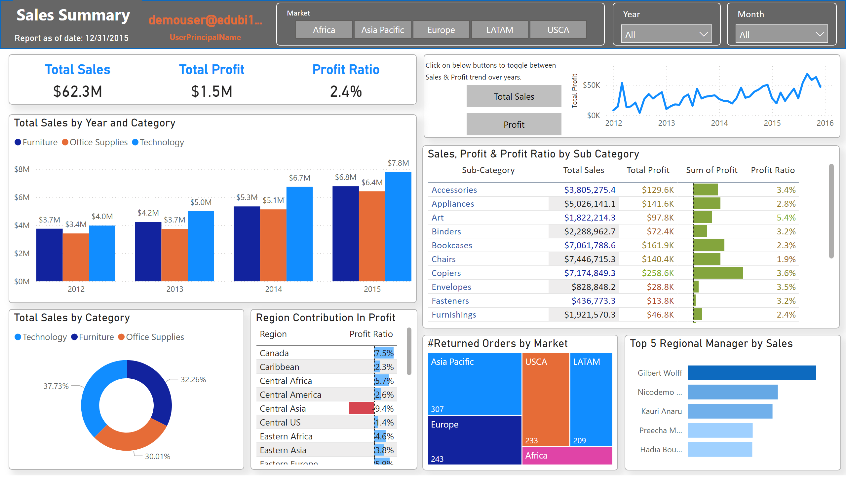
Sales Summary
Notes:
shape
No alt text provided
textbox
No alt text provided
card
No alt text provided
slicer
No alt text provided
slicer
No alt text provided
slicer
No alt text provided
clusteredColumnChart
No alt text provided
donutChart
No alt text provided
Region Contribution In Profit
No alt text provided
shape
No alt text provided
textbox
No alt text provided
Sales, Profit & Profit Ratio by Sub Category
No alt text provided
#Returned Orders by Market
No alt text provided
Top 5 Regional Manager by Sales
No alt text provided
card
No alt text provided
cardVisual
No alt text provided
lineChart
No alt text provided
lineChart
No alt text provided
actionButton
No alt text provided
actionButton
No alt text provided

Slide 3
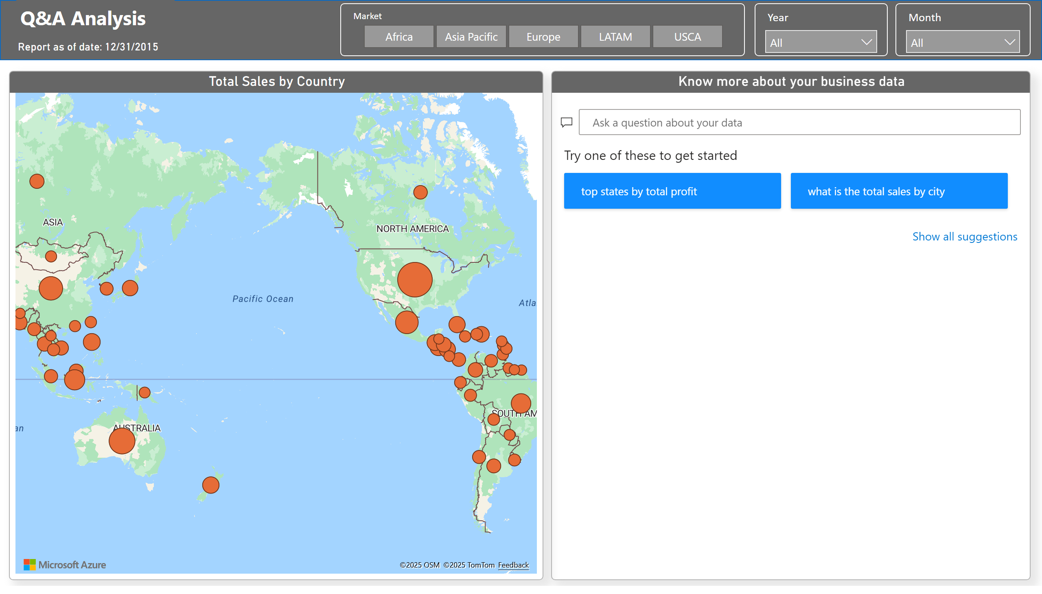
Q&A Analysis
Notes:
slicer
No alt text provided
slicer
No alt text provided
slicer
No alt text provided
Know more about your business data
No alt text provided
azureMap
No alt text provided
card
No alt text provided
textbox
No alt text provided
shape
No alt text provided

